Slide 1
Introducing Entity Object Business Rules
(Section 4)

Slide 2
Defining Validation and Business Rules Declaratively
Ensuring the validity of business data is critical for any enterprise application. ADF Business Components are packaged with a set of built-in validation rules. You can even add more rules, if the existing rules do not meet your requirements.

Slide 3
Understanding the Validation Cycle
Attribute-Level Validation Rules
Attribute-level validation rules are triggered when client attempts to modify an attribute's value.
Entity-Level Validation Rules
All other kinds of validation rules are entity-level validation rules. These are rules whose implementation requires considering two or more entity attributes, or possibly composed children entity rows, in order to determine the success or failure of the rule.
Entity-level validation rules are triggered by calling the validate() method on a Row. This occurs when:
You call the method explicitly on the entity object
You call the method explicitly on a view row with an entity row part that is invalid
A view object's iterator calls the method on the current row in the view object before allowing the current row to change
Before proceeding with posting the changes to the database

Slide 4
Understanding Commit Processing and Validation
Transaction commit processing happens in three basic phases:
Ensure that any invalid entity rows on the pending changes list are valid.
Post the pending changes to the database by performing appropriate DML operations.
Commit the transaction.

Slide 5

Adding Validation Rules to Entity Objects and Attributes
You can open “Business Rules” page from the entity object editor by clicking “Create new validation” button.
The rule definition you provide specifies the valid condition for the attribute or entity object.
Entity-level validation rules are enforced when a user tries to commit pending changes or navigates between rows.
Attribute-level validation rules are enforced when the user changes the value of the related attribute.

Slide 6
Using the Built-in Declarative Validation Rules
The built-in declarative validation rules can satisfy many, if not all, of your business needs. These rules are easy to implement because you don’t write any code. You use the user-interface tools to choose the type of validation and how it is used.
Built-in declarative validation rules can be used to:
Ensure that key values are unique (primary key or other unique keys).
Determine the existence of a key value.
Make a comparison between an attribute
Validate against a list of values that
Make sure that a value falls within a certain range, or that it is limited by a certain number of bytes or characters.
Validate using a regular expression or evaluate a Groovy expression.
Make sure that a value satisfies a relationship defined by an aggregate on a child entity available through an accessor.
Validate using a validation condition defined in a Java method on the entity.

Slide 7
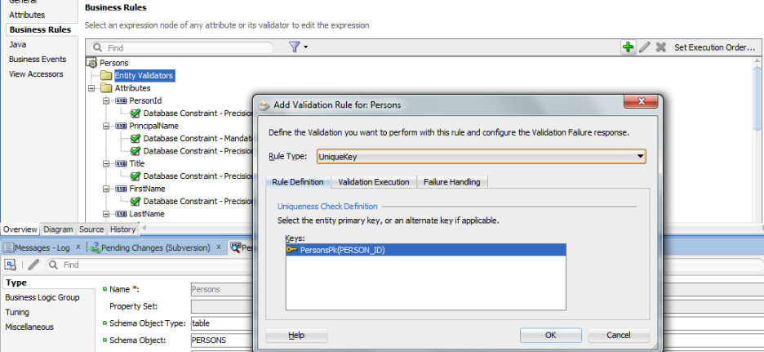
Ensure That Key Values Are Unique
The Unique Key validator ensures that primary key values for an entity object are always unique (<UniqueKeyValidationBean> Tag in Entity)
2
1
3

Slide 8
Validate Based on a Comparison
The Compare validator performs a logical comparison between an entity attribute and a value. (CompareValidationBean )You can compare the following:
Literal value
Query result
When you use this type of validator, the SQL query is executed each time the validator is executed. The validator retrieves the first row from the query result, and it uses the value of the first column in the query
View object attribute
The validator retrieves the first row from the query result, and it uses the value of the selected view object attribute from that row as the value to compare
View accessor attribute
When defining the view accessor, you can assign row-specific values to the validation view object's bind variables
Expression
Using Groovy Expressions for Validation and Business Rules.
Entity attribute
The entity attribute option is available only for entity-level Compare validators.

Slide 9
Validate Using a List of Values
The List validator compares an attribute against a list of values (LOV). When you add a List validator, you specify the type of list to choose from: <ListValidationBean> tag
Literal values - A list of literal values in separate rows.
Query result - The validator ensures that the entity attribute is in (or not in, if specified) the first column of the query's result set
View object attribute - The validator ensures that the entity attribute is in (or not in, if specified) the view attribute. The View attribute validator cannot use a bind variable
View accessor attribute - The validator ensures that the entity attribute is in (or not in) the view accessor attribute. The view accessor is probably the most useful option, because it can take bind variables and after you’ve created the LOV on the user interface, a view accessor is required.

Slide 10
Make Sure a Value Falls in Certain Range
The Range validator performs a logical comparison between an entity attribute and a range of values. When you add a Range validator, you specify minimum and maximum literal values. <RangeValidationBean> tag in entity.

Slide 11
Validate Against a Number of Bytes or Characters
The Length validator validates whether the string length (in characters or bytes) of an attribute's value is less than, equal to, or greater than a specified number, or whether it lies between a pair of numbers. <LengthValidationBean> tag in entity.

Slide 12
Validate Using a Regular Expression
The Regular Expression validator compares attribute values against a mask specified by a Java regular expression. <RegExpValidationBean> Tag in entity
Note: You can add your own expressions to the list of predefined expressions.
C:\Users\Std-6\AppData\Roaming\JDeveloper\system11.1.2.3.39.62.76.1\o.BC4J \PredefinedRegExp.properties).

Slide 13
Use the Average, Count, or Sum to Validate a Collection
You can use collection validation on the average, count, sum, min, or max of a collection. This validator is available only at the entity level. <CollectionValidationBean> tag in entity

Slide 14
Determine Whether a Key Exists
The Key Exists validator is used to determine whether a key value (primary, foreign or alternate key) exists. <ExistsValidationBean> tag is entity.
There are a couple of benefits to using the Key Exists validator:
The Key Exists validator has better performance because it first checks the cache and only goes to the database if necessary.
Since the Key Exists validator uses the cache, it will find a key value that has been added in the current transaction, but not yet committed to the database.

Slide 15
Using Groovy Expressions For Validation and Business Rules
Groovy expressions are Java-like scripting code stored in the XML definition of an entity object. Because Groovy expressions are stored in XML, you can change the expression values even if you don’t have access to the entity object’s Java file
You can call methods on the current entity instance using the source property of the current object. The source property allows you to access to the entity instance being validated
You can use a Groovy expression to return a true/false statement. The Script Expression validator requires that the expression either return true or false, or that it calls the adf.error.raise/warn() method.
newValue <= (new java.sql.Timestamp(System.currentTimeMillis()))

Slide 16
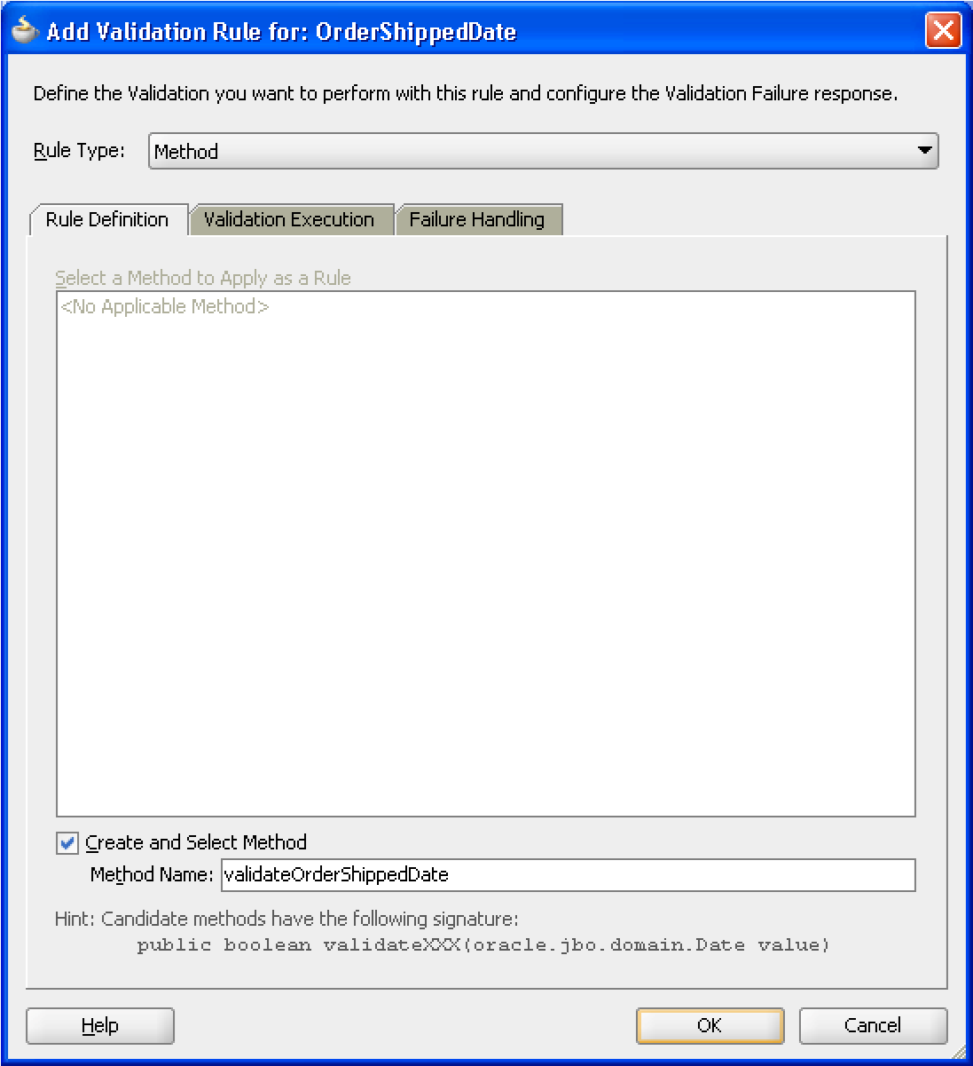
Create a Method Validator
The use of method validators is a programmatic approach that supplements your declarative validation rules.

Slide 17
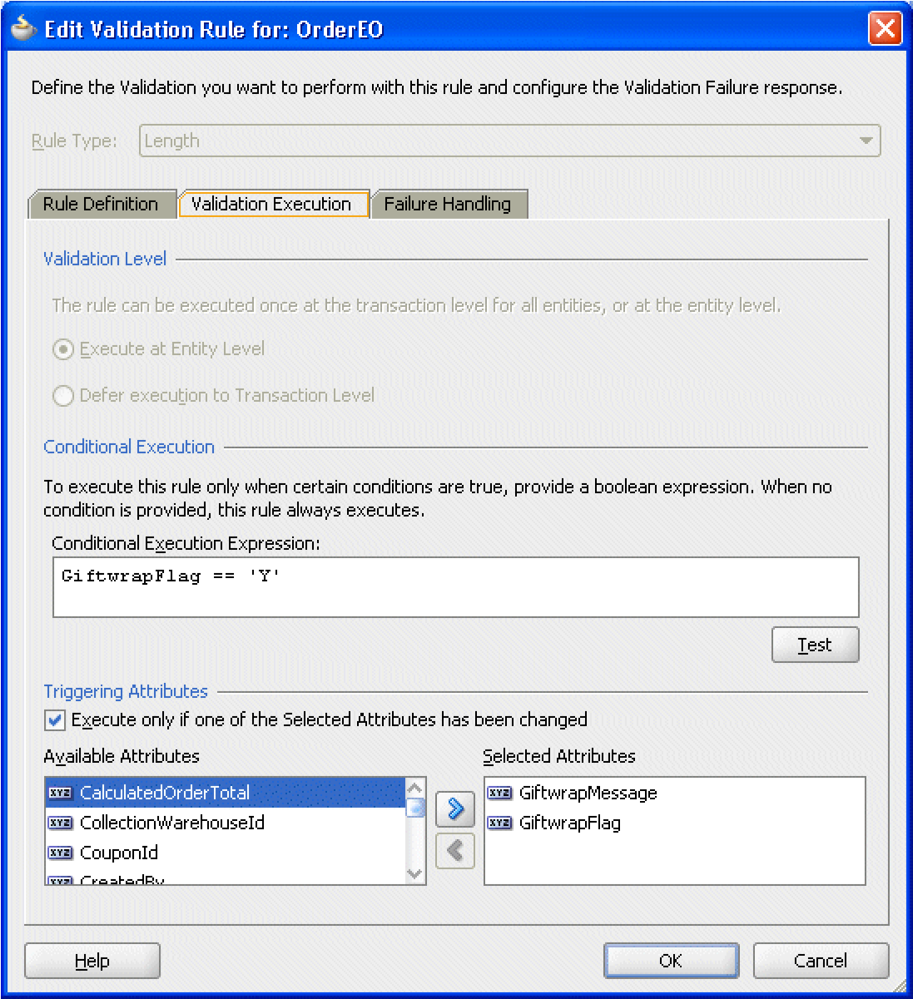
Specify Which Attributes Fire Validation
When defining a validator at the entity level, you have the option of selecting one or more attributes of the entity object that, when changed, trigger execution of the validator.

Slide 18
Set Preconditions for Validation
The Validation Execution tab (on the Add/Edit Validation Rule dialog) allows you to add a Groovy expression that serves as a precondition. If you enter an expression in the Conditional Execution Expression box, the validator is executed only if the condition evaluates True

Slide 19
How to Set Transaction-Level Validation
Transaction-level validation is only applicable to Key Exists and Method entity validators.
Performing a validation during the transaction level (rather than entity level) means that the validation will be performed after all entity-level validation is performed. For this reason, it may be useful if you want to ensure that a validator is performed at the end of the process.

Slide 20
Creating Validation Error Messages
You can use the adf.error.raise() and adf.error.warn() methods to conditionally raise one error message or another depending upon branching in the Groovy expression. For example, if an attribute value is x, then validate as follows, and if the validation fails, raise error messageA; whereas if the attribute value is y, then instead validate a different way and if validation fails, raise error messageB.
If the expression returns false (versus raising a specific error message using the raise() method), the validator calls the first error message associated with the validator.

Slide 21
Embed a Groovy Expression in an Error Message
A validator's error message can contain embedded expressions that are resolved by the server at runtime. To access this feature, simply enter a named token delimited by curly braces (for example, {2} or {errorParam}) in the error message text where you want the result of the Groovy expression to appear.
After entering the token into the text of the error message (on the Failure Handling tab of the Edit Validation Rule dialog), the Token Message Expressions table at the bottom of the dialog displays a row that allows you to enter a Groovy expression for the token.
You can set the severity level for validation exceptions to two levels, Informational Warning and Error. If you set the severity level to Informational Warning, an error message will display, but processing will continue. If you set the validation level to Error, the user will not be able to proceed until you have fixed the error.

